Slide 1
Places
Advanced Android Development
Lesson 8

Slide 2

8.1 Using the Places API
Search for and get details about a specific place

Slide 3
Contents
Overview and API setup
Setting up permission
Using place details
Using the PlacePicker UI
Getting nearby places
Using the PlaceAutocomplete service

Slide 4
Overview and API setup

Slide 5
What is a "place" in Google Maps?
A place:
Physical space that has a name and is on a map—includes businesses, points of interest, and geographic locations
A Place object:
Represents a place
Can include name, address, geographical location, place ID, phone number, place type, website URL, and more

Slide 6
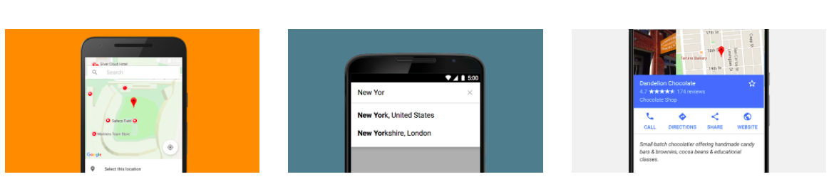
Places API
Places API
Get data from same database used by Google Maps

Slide 7
Access the Places API
PlacePicker: Lets user search and select a place on map
PlaceDetectionApi: Access to device's current place
GeoDataApi: Access to Google's database of local place and business information, including images
PlaceAutocomplete: Lets user search for specific place with autocomplete suggestions

Slide 8
Requirements to use Places API
Set up Google Play services
Add Google Play services dependency to your project
Register your app and get API key

Slide 9
Set up Google Play services
Steps to install Google Repository in Android Studio
Select Tools > Android > SDK Manager
Select the SDK Tools tab
Expand Support Repository
Select Google Repository and click OK

Slide 10
Add Google Play services to project
Add to dependencies in build.gradle (Module: app):
compile 'com.google.android.gms:play-services:x.x.x'
x.x.x is latest version suggested by Android Studio

Slide 11
Register your app and get API key
Register your app in Google API Console
Get info for debug certificate and release certificate
Enable Google Places API and request API key
Add API key to AndroidManifest.xml
<application> //...
<meta-data
android:name="com.google.android.geo.API_KEY"
android:value="YOUR_API_KEY"/>

Slide 12
Setting up location permission

Slide 13
Request permission at runtime
User can revoke permission at any time
Check for permission each time your app uses location
Details and examples: Requesting Permissions at Runtime

Slide 14
Permission to get location
App must request ACCESS_FINE_LOCATION permission
Add to AndroidManifest.xml:
<uses-permission android:name="android.permission.ACCESS_FINE_LOCATION"/>

Slide 15
Steps to check/request permission
In Activity or Fragment, define integer for requestCode parameter
private static final int REQUEST_LOCATION_PERMISSION = 1;
Use checkSelfPermission() to see if permission granted
Use requestPermissions() to request permission
Check user response to see if request was granted

Slide 16
Check/request permission
if (ActivityCompat.checkSelfPermission(this,
Manifest.permission.ACCESS_FINE_LOCATION) !=
PackageManager.PERMISSION_GRANTED) {
ActivityCompat.requestPermissions(this, new
String[]{Manifest.permission.ACCESS_FINE_LOCATION},
REQUEST_LOCATION_PERMISSION);
} else {
Log.d(TAG, "getLocation: permissions granted");
}

Slide 17
Get user's response
Override onRequestPermissionsResult() to check if returned requestCode is REQUEST_LOCATION_PERMISSION
@Override
public void onRequestPermissionsResult(int requestCode,
String permissions[], int[] grantResults) {
switch (requestCode) {
case REQUEST_LOCATION_PERMISSION: {
// Check if the permission is granted.

Slide 18
Check if request was granted
Response is returned in permissions array
Compare grantResults parameter to PERMISSION_GRANTED
// Check if the permission is granted.
if (grantResults.length > 0) && grantResults[0] ==
PackageManager.PERMISSION_GRANTED) {
// Permission was granted.
// Code to use Places...
} else {
// Permission was denied...

Slide 19
Using place details
The Place object and place ID

Slide 20
Place ID
Text ID that uniquely identifies place
To retrieve place ID, call Place.getId()
Use place ID to retrieve Place object
To get place by ID, call GeoDataClient.getPlaceById() and pass one or more place IDs
Returns PlaceBuffer in Task
Buffer contains list of Place objects matching place IDs

Slide 21
Place details
Get Place object:
Call PlaceDetectionClient.getCurrentPlace()
More info, see Current Place
Add a PlacePicker and call PlacePicker.getPlace()
Call GeoDataClient.getPlaceById()
More info, see Get a place by ID

Slide 22
Retrieve data from a Place object (1)
getName() | Place name
getAddress() | Place address, in human-readable form
getID() | Place ID
getPhoneNumber() | Place phone number
getWebsiteUri() | URI of place website (or null)
getLatLng() | Place latitude and longitude

Slide 23
Retrieve data from a Place object (2)
.
getViewport() | LatLngBounds for displaying place on map (or null)
getLocale() | Locale for which the name and address are localized
getPlaceTypes() | List of place types for this place—see list of available place types in Place interface
getPriceLevel() | Price level from 0 (cheapest) to 4 (most expensive)
getRating() | Aggregated user rating (float 1.0 to 5.0)

Slide 24
Example: Get place ID
mGeoDataClient.getPlaceById(placeId).addOnCompleteListener(new
OnCompleteListener<PlaceBufferResponse>() {
@Override
public void onComplete(@NonNull Task<PlaceBufferResponse> task) {
if (task.isSuccessful()) {
PlaceBufferResponse places = task.getResult();
Place myPlace = places.get(0);
Log.i(TAG, "Place found: " + myPlace.getName());
places.release();
} else {
Log.e(TAG, "Place not found.");
}
}});

Slide 25
Using PlacePicker
Getting the current place

Slide 26
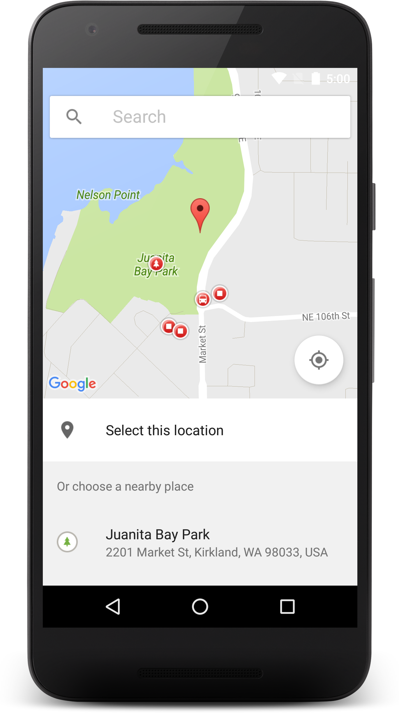
PlacePicker
Displays interactive map and list of nearby places
User can select or search for place
App retrieves details of selected place, needs ACCESS_FINE_LOCATION permission

Slide 27
Add listener to fragment
@Override
public void onPlaceSelected(Place place) {
// TODO: Get info about the selected place.
Log.i(TAG, "Place: " + place.getName());
}
@Override
public void onError(Status status) {
// TODO: Handle the error.
Log.i(TAG, "An error occurred: " + status);
}
});

Slide 28
Launch PlacePicker UI
Use PlacePicker.IntentBuilder() to construct Intent
Defines a viewport centered on device's location
Zoom is set at city-block level
To change default lat/long bounds of map call setLatLngBounds() and pass in LatLngBounds
Call startActivityForResult() and pass in Intent and predefined request code

Slide 29
Example: Launch PlacePicker
PlacePicker.IntentBuilder builder =
new PlacePicker.IntentBuilder();
try {
// Launch the PlacePicker.
startActivityForResult(builder.build(MainActivity.this),
REQUEST_PICK_PLACE);
} catch (GooglePlayServicesRepairableException
| GooglePlayServicesNotAvailableException e) {
e.printStackTrace();
}

Slide 30
Get user-selected place
Activity calls onActivityResult() with request code used in startActivityForResult()
Call PlacePicker.getPlace() in onActivityResult() and pass in activity context and Intent
Get most recent bounds of map by calling PlacePicker.getLatLngBounds()

Slide 31
Example: Get user-selected place
@Override
protected void onActivityResult(int requestCode,
int resultCode, Intent data) {
if (resultCode == RESULT_OK) {
Place place = PlacePicker.getPlace(this, data);
setAndroidType(place);
mLocationTextView.setText(getString
(R.string.address_text, place.getName(),
place.getAddress(),System.currentTimeMillis()));
} else { // ... }
super.onActivityResult(requestCode, resultCode, data);
}

Slide 32
Getting nearby places

Slide 33
Get places at device location
Use PlaceDetectionClient.getCurrentPlace()
Optionally pass in PlaceFilter to filter list of places
Returns Task containing PlaceLikelihoodBuffer –list of PlaceLikelihood objects
Release PlaceLikelihoodBuffer when app no longer needs it to prevent memory leaks

Slide 34
Use PlaceLikelihood interface
PlaceDetectionClient.getCurrentPlace() returns Task
Contains PlaceLikelihoodBuffer list of PlaceLikelihood objects representing likely places
Use PlaceLikelihood.getLikelihood for indication of likelihood that place is right (ranges 0.0-1.0)
Use PlaceLikelihood.getPlace to get Place object

Slide 35
Example: Get places at device location (1)
Task<PlaceLikelihoodBufferResponse> placeResult =
mPlaceDetectionClient.getCurrentPlace(null);
placeResult.addOnCompleteListener
(new OnCompleteListener<PlaceLikelihoodBufferResponse>() {
@Override
public void onComplete(@NonNull
Task<PlaceLikelihoodBufferResponse> task) {
// If result, get most likely place ...

Slide 36
Example: Get places at device location (2)
// If result, get most likely place ...
if (task.isSuccessful()) {
PlaceLikelihoodBufferResponse likelyPlaces = task.getResult();
float maxLikelihood = 0;
Place currentPlace = null;
for (PlaceLikelihood placeLikelihood : likelyPlaces) {
// ...

Slide 37
Example: Get places at device location (3)
// ...
if (maxLikelihood < placeLikelihood.getLikelihood()) {
maxLikelihood = placeLikelihood.getLikelihood();
currentPlace = placeLikelihood.getPlace();
}
}
// Update the UI ...
// Release the buffer.
likelyPlaces.release();
// Otherwise, show an error ...

Slide 38
Filter the list of places
Include PlaceFilter constructor to limit results included in PlaceLikelihoodBuffer
PlaceFilter(boolean requireOpenNow, Collection<String> restrictToPlaceIds)
For places currently open, pass true as requireOpenNow
For places that match list of place IDs, pass IDs as restrictToPlaceIds

Slide 39
Using Place
Autocomplete

Slide 40
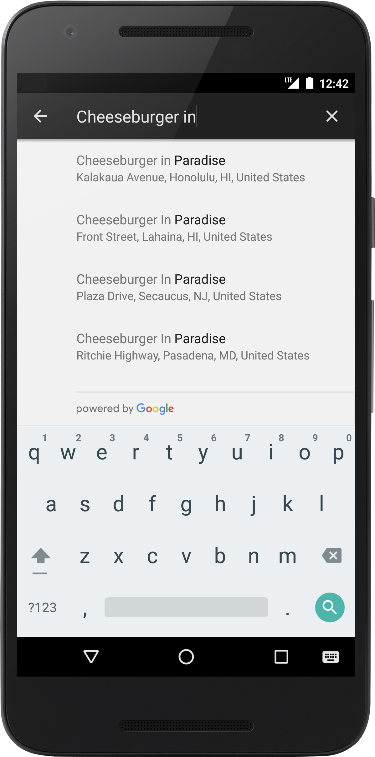
PlaceAutocomplete
Add PlaceAutocomplete UI element to your app
Returns Place suggestions based on user search queries
Saves development time and ensures a consistent user experience
Get place predictions programmatically to create custom UI

Slide 41
How place suggestions work
User enters search terms
Search dialog presents list of predicted places
If user makes selection, Place is returned
App can use Place to get details

Slide 42
Use the autocomplete UI widget
Choose fragment OR activity:
Use PlaceAutocompleteFragment for fragment
Use PlaceAutocomplete.IntentBuilder to create intent to launch autocomplete activity

Slide 43
Add fragment to XML layout
Use PlaceAutocompleteFragment for fragment
<fragment
android:id="@+id/place_autocomplete_fragment"
android:layout_width="match_parent"
android:layout_height="wrap_content"
android:name="com.google.android.gms.location.places
.ui.PlaceAutocompleteFragment"
/>

Slide 44
Add listener to fragment
PlaceSelectionListener handles returning Place in response to user's selection
PlaceAutocompleteFragment autocompleteFragment =
(PlaceAutocompleteFragment) getFragmentManager()
.findFragmentById(R.id.place_autocomplete_fragment);
autocompleteFragment.setOnPlaceSelectedListener(new
PlaceSelectionListener() {
// Override onPlaceSelected ...

Slide 45
Launch autocomplete activity
Use PlaceAutocomplete.IntentBuilder to create intent to launch autocomplete activity
Pass in PlaceAutocomplete display mode—overlay or full-screen
Call startActivityForResult(), passing in request code that identifies intent
Override onActivityResult() to receive selected place

Slide 46
Use PlaceAutocomplete.IntentBuilder
int PLACE_AUTOCOMPLETE_REQUEST_CODE = 1;
// ...
try {
Intent intent = new PlaceAutocomplete
.IntentBuilder(PlaceAutocomplete.MODE_FULLSCREEN).build(this);
startActivityForResult(intent,PLACE_AUTOCOMPLETE_REQUEST_CODE);
} catch (GooglePlayServicesRepairableException e) {
// TODO: Handle the error.
} catch (GooglePlayServicesNotAvailableException e) {
// TODO: Handle the error.
}

Slide 47
Override onActivityResult (1)
@Override
protected void onActivityResult(int requestCode, int resultCode,
Intent data) {
if (requestCode == PLACE_AUTOCOMPLETE_REQUEST_CODE) {
if (resultCode == RESULT_OK) {
Place place = PlaceAutocomplete.getPlace(this, data);
Log.i(TAG, "Place: " + place.getName());
} else if (resultCode == PlaceAutocomplete.RESULT_ERROR) {
Status status = PlaceAutocomplete.getStatus(this, data);
// TODO: Handle the error.
// ...

Slide 48
Override onActivityResult (2)
// TODO: Handle the error.
Log.i(TAG, status.getStatusMessage());
} else if (resultCode == RESULT_CANCELED) {
// The user canceled the operation.
}
}
}

Slide 49
Restrict autocomplete search results
Your app can
Bias results to specific geographic region
Filter results to a specific place type
Filter results to a specific country

Slide 50
Getting place predictions in custom UI
Get list of predicted place names and/or addresses by calling GeoDataClient.getAutocompletePredictions()
Pass parameters:
Query string with user text
LatLngBounds object (biases results to specific area)
Optional: AutocompleteFilter with place types to restrict results
getAutocompletePredictions() is subject to tiered query limits—for details, see Usage Limits

Slide 51
Custom search place predictions
API returns AutocompletePredictionBuffer in a Task
Buffer contains list of AutocompletePrediction objects representing predicted places
Release AutocompletePredictionBuffer when app no longer needs it
More info: see Handling buffers

Slide 52
Getting place details

Slide 53
Retrieve place details
getFullText(CharacterStyle matchStyle) returns full text description and highlights sections matching search (use CharacterStyle or null)
getPrimaryText(CharacterStyle matchStyle) returns main text, usually a name
getSecondaryText(CharacterStyle matchStyle) returns subsidiary text

Slide 54
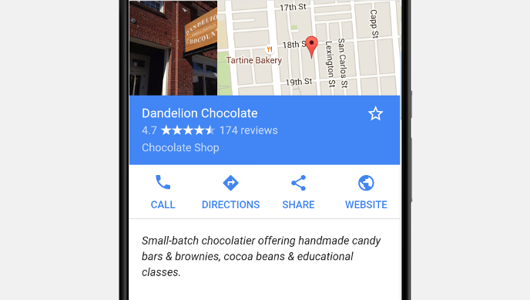
Retrieve place details

Slide 55
Request place photos to display
Call GeoDataClient.getPlacePhotos() and pass string with place ID
Returns PlacePhotoMetadataResult instance in Task
Call getPhotoMetadata() on PlacePhotoMetadataResult instance
Returns PlacePhotoMetadataBuffer with list of PlacePhotoMetadata instances, one for each photo

Slide 56
Custom search display attributions
UI must display a "Powered by Google" attribution or appear within a Google-branded map.
If you retrieve and display additional place information after getting place by ID, display third-party attributions
If you use autocomplete UI element, no additional action required, because required attribution is displayed by default

Slide 57
What's next?
Concept chapter: 8.1 Places API
Practical: 8.1 Using the Places API

Slide 58
END

